Slide 1
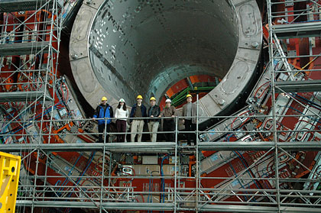
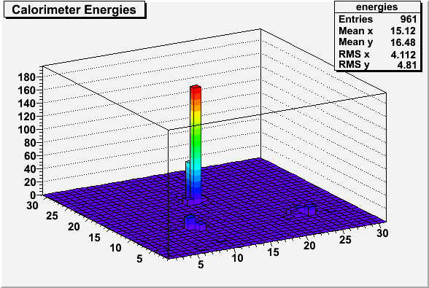
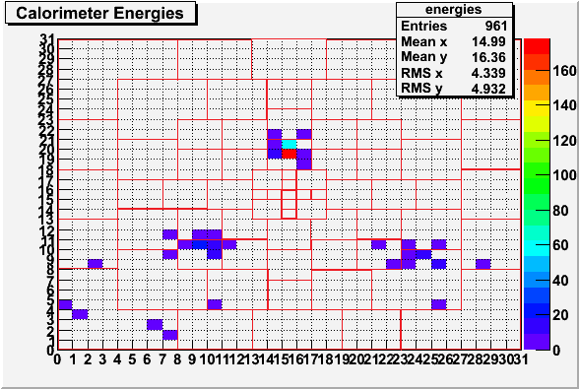
Use of Neural Networks to find Evidence of
Extra Dimensions of Spacetime
David M. Nisson
Sponsor, Dr. John Conway
Department of Physics
University of California, Davis, 95616
The Randall-Sundrum theory [1] of extra spacetime dimensions predicts the existence of Kaluza-Klein (KK) gluons with masses on the order of 1 TeV. These may decay preferentially into top-antitop quark pairs [2]. Our goal is to produce neural networks that can distinguish these from ordinary dijet events by their pattern of energy deposition in two-dimensional calorimeter arrays in the Compact Muon Solenoid experiment at the Large Hadron Collider. We will begin by simulating calorimeter energy deposits due to both types of events, and then using the simulation output to train and test the neural network. I already have written code that can represent an artificial neural network and train and test it. We will show the result of testing the neural network on simulated data. Finding evidence for the top-antitop pairs could be the first indication of extra dimensions of space-time.
An Artificial Neural Network
Output Node
Above is an illustration of how a top-antitop event (left) and a dijet event (right) might deposit energy into the calorimeters (red line). Each jet produces a corresponding “bump” in the energies (brown line shows the distribution). Neural networks may help distinguish these distributions electronically.
Input
Nodes
Hidden Nodes
Photo of CMS detector under construction. (http://www.ucdavis.edu/images/features_level2/0908/DSC_0584.jpg)
Neural networks will help UC Davis physicists to recognize top-antitop events in a background of dijet events.
If UC Davis experimentalists find top-antitop pairs at the Compact Muon Solenoid, this could signify the existence of Kaluza-Klein gluons.
These gluons are an indicator of space-time dimensions beyond the three of space, and one of time, that we see today.
t
p
p
References
Randall, Lisa and Sundrum, Raman. Large Mass Hierarchy from a Small Extra Dimension. Phys. Rev. Lett. Vol. 83, Issue 17, p. 3370-3373. (http://prola.aps.org/abstract/PRL/v83/i17/p3370_1)
K. Agashe, et al., "LHC Signals from Warped Extra Dimensions", Phys. Rev. D77:015003,2008
UC Davis Experimental High Energy Physics. (http://ucdcms.ucdavis.edu/)
t
Lego (top) and color (bottom) plots of calorimeter energies for a computer-simulated top-antitop event. Each area marked by red lines in the color plot corresponds to a single input to the neural network.
A top-antitop event
A dijet event

